Slide 1
Introduction to Statistics and Experimental Design
Reuben Thomas
Gladstone Bioinformatics Core
2/22/2022

Slide 2
About this course
Very basic introduction to concepts underpinning statistics and experimental design
Goal is to get you thinking a little deeper about the data you want to generate and use to make claims about
No prerequisites
Please interrupt with questions and comments!

Slide 3

Thanks: Kevin Mullane
Director, Corporate Liaison & Ventures
Corporate Ventures and Translation
Gladstone Institutes

Slide 4
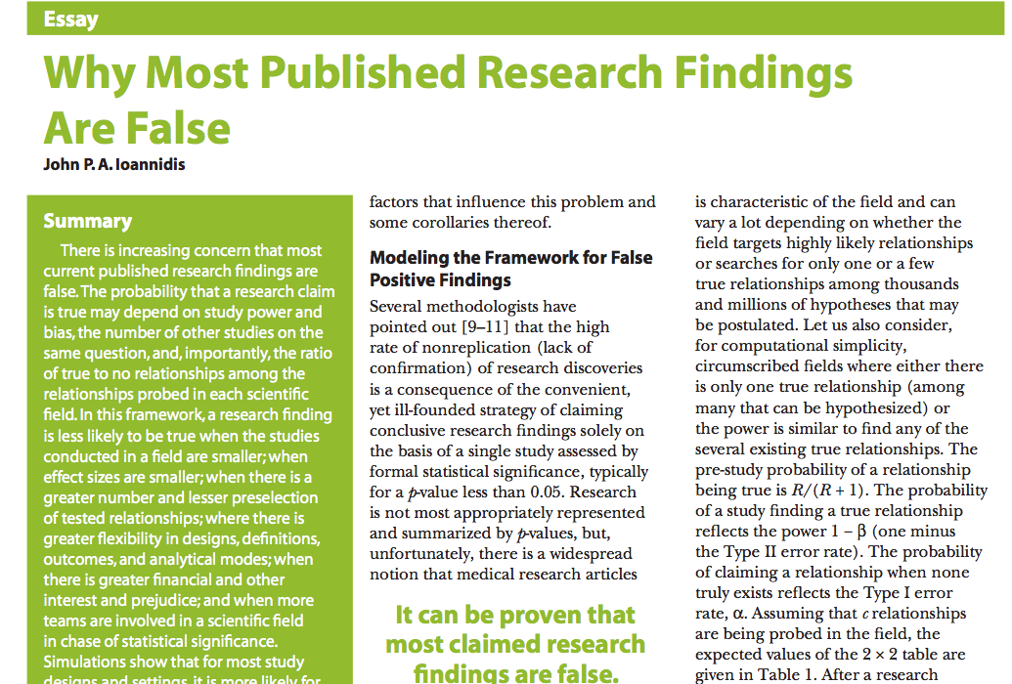
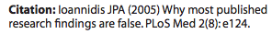

Slide 5
Motivation for use of Statistics
We would like to make scientific claims that are as generalizable as possible
However,
Empirical data are inherently noisy
Resources are limited
Enter Statistics!

Slide 6

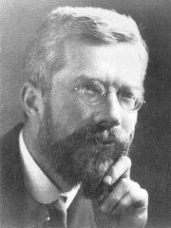
Historical figures
Ibn Sina
Ronald Fisher
1000 C.E., Cannon of Medicine
1920 CE, Design of Experiments
http://www.newworldencyclopedia.org/entry/Ronald_Fisher
https://en.wikipedia.org/wiki/Avicenna#/media/File:Avicenna_Portrait_on_Silver_Vase_-_Museum_at_BuAli_Sina_(Avicenna)_Mausoleum_-_Hamadan_-_Western_Iran_(7423560860).jpg

Slide 7
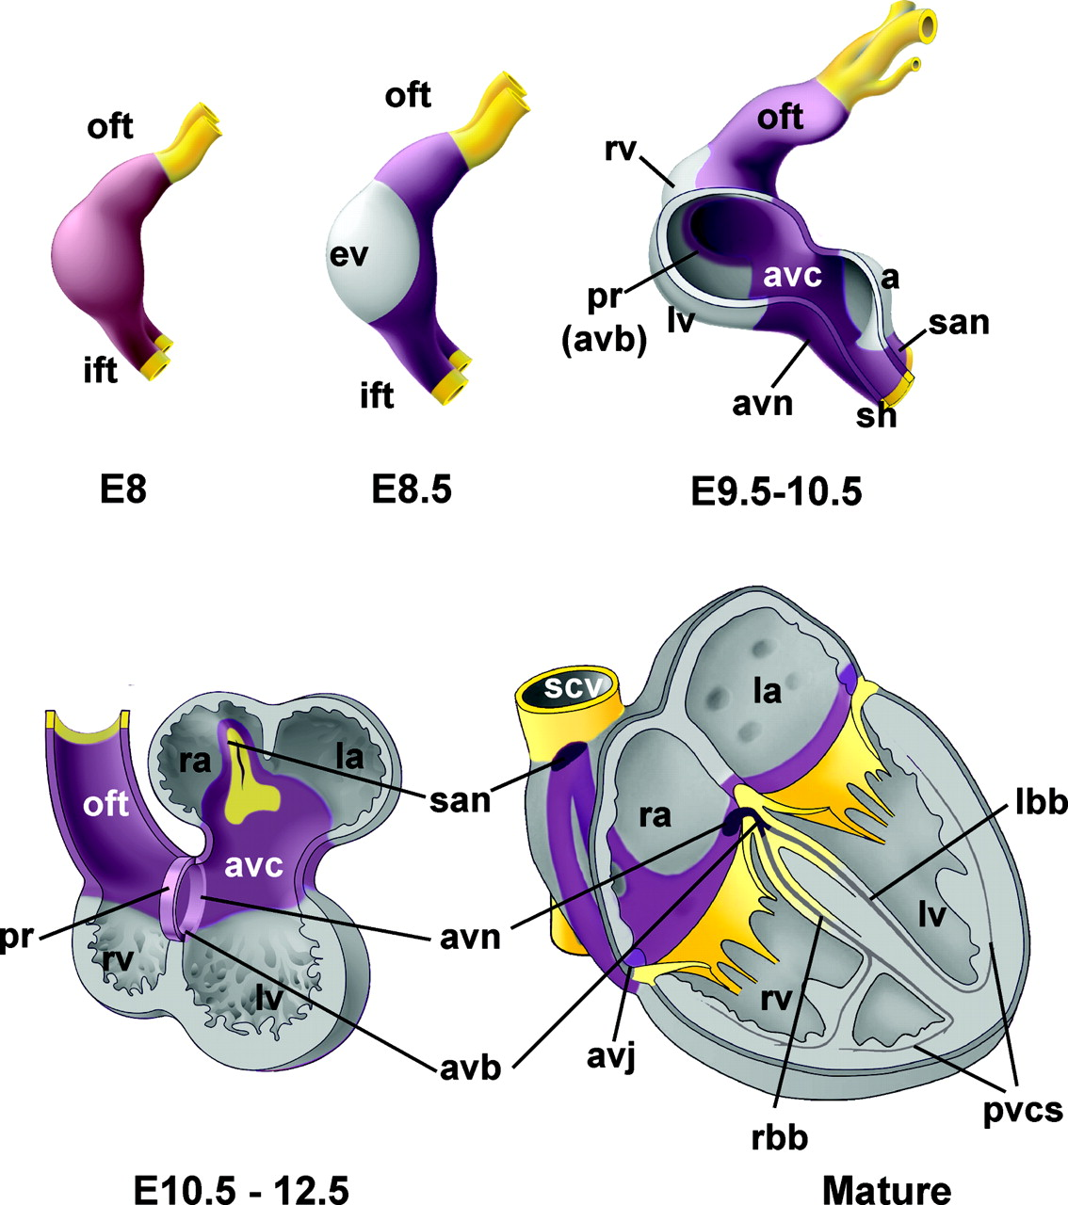
Experiment: Gene controlling developing heart
Notes:
https://www.ahajournals.org/doi/epub/10.1161/CIRCEP.108.829341

Slide 8

Seven pillars of statistical wisdom
Aggregation
Information
Inter-comparison
Likelihood
Regression
Residuals
Experimental design
https://commons.wikimedia.org/wiki/File:Seven_Pillars_2008_e5.jpg
Stephen M. Stigler. 2016. Seven Pillars of Statistical Wisdom. Harvard University Press

Slide 9
Poll: Is the gene differentially expressed between these two time-points?
Intuition: The scatter of expression values at E11.5 is shifted up compared to E9.5
Quantitative: The mean of expression values at E11.5 is shifted up compared to the
Mean of expression values at E9.5 by 15 units

Slide 10
1. Aggregation: one number to capture an entire distribution

Slide 11
Poll: Over what group of samples is the mean expression implied when we say that the mean of the expression of the genes is shifted up?

Slide 12
Target population
All subjects/units that we want base our claims/conclusions on
The cardiac tissue of all mice at embryonic stage E9.5
All children below 5 years old who are diagnosed with autism

Slide 13
Seven pillars of statistical wisdom
Aggregation
Information
Inter-comparison
Likelihood
Regression
Residuals
Experimental design
https://commons.wikimedia.org/wiki/File:Seven_Pillars_2008_e5.jpg
Stephen M. Stigler. 2016. Seven Pillars of Statistical Wisdom. Harvard University Press

Slide 14
How many samples does one need to get “sufficient” information about the location/mean of a given distribution?
More the better….

Slide 15
2. Information on aggregate measure: rate of gain decreases with increasing sample size

Slide 16
Poll: Dr. Shady Joe was told that he needed 10 measurements of Sars-CoV-2 antibodies in a local county to get an accurate measure of seroprevalence in this population. He asked a friend to submit their samples for testing on multiple days to make up this number. Did he get an accurate measure of seroprevalence in this population?
It is important to get samples representative of the population over which you want to
base your conclusions on!

Slide 17
Seven pillars of statistical wisdom
Aggregation
Information
Inter-comparison
Likelihood
Regression
Residuals
Experimental design
https://commons.wikimedia.org/wiki/File:Seven_Pillars_2008_e5.jpg
Stephen M. Stigler. 2016. Seven Pillars of Statistical Wisdom. Harvard University Press

Slide 18
3. Inter-comparison: with limited data can make conclusions applicable to larger target population

Slide 19
Is gene differentially expressed between the two developmental time-points?

Slide 20
Convince a skeptic: Repeat this experiment 1000 times
You will obtain the sampling distribution of the difference in means when you normalize the
y-axis and perform “infinite” experiments

Slide 21
Sampling distribution captures the distribution of the chosen statistic over repeated experiments
Area under the curve provides the fraction of time one observes given ranges of the difference
in means

Slide 22
Poll: What is your best estimate of the fraction of time one would observe values of the difference of means between -30 and 30?

Slide 23
Central limit theorem allows us to estimate the variation of the location of the sampling distribution over repeated experiments
The sampling distribution of the mean approaches a normal distribution as the size of the sample increases, regardless of the shape of the original population distribution

Slide 24
Two conclusions from the data
Conclusion 1: The difference is interesting, biologically meaningful – PI happy, start writing manuscript, plan further experiments.
Conclusion 2: Skeptical viewpoint, there is no difference, or unable to conclude that there is one – back to the drawing board.
All statistical hypothesis testing is based on the latter the skeptical viewpoint

Slide 25
Theoretical distribution of difference in means under the skeptical view-point/Null hypothesis (H0)
You will need to make a decision
Choose a decision point on this distribution
Observed difference
You will be mistaken that there is a true
relationship p–value fraction of time you
repeat the experiment
You are willing to be mistaken that there is a true
difference Type I error fraction of time you repeat this
experiment
Type I error and p-value

Slide 26
Poll: You choose a Type I error value of 0.05. What is the percentage of time you repeat the experiment that you will correctly claim that there is no difference when there really isn’t?

Slide 27
Poll: You are convinced that there is a real difference in the mean gene expression, when in fact there isn’t a difference. You are flush with money, ☺, and so you decide to repeat the experiment a 100 times. Each time you base your decision using a Type I error value of 0.05. How many times will you come up with an inference that there is a difference?

Slide 28
Poll: You are convinced that there is a real difference in the mean gene expression in a fraction of 100 chosen genes, when in fact there isn’t a difference in any of them. You perform a targeted gene expression assay. For each gene, you base your decision using a Type I error value of 0.05. How many times will you come up with an inference that there is a difference?

Slide 29
How does the sampling distribution change with varying underlying variation?
sd=14
sd=24
sd=4
Larger the variance of the response is the wider is the sampling distribution

Slide 30
How does the sampling distribution change with the number of replicates?
n=4
n=3
n=15
Smaller the number of replicates sampled the wider is the sampling distribution

Slide 31
Power to detect a difference of means of -15
Type I and Type II error
You are willing to be mistaken that there is a true difference Type I error fraction of time you repeat this experiment
You are mistaken that there is no difference Type II error fraction of time you repeat this experiment
Power = 1 – Type II error
You correctly say that there is a difference Power fraction of time you repeat this experiment

Slide 32
Poll: What are the factors that affect Type II error or the fraction of time you claim that there is no real difference when there is actually a difference?

Slide 33
Power to detect varying levels of difference in mean differences
Mean diff = -15
Mean diff = -25
Mean diff = -5
Type II error smaller for larger effect sizes
Larger effect sizes are easier to estimate compared to smaller effect sizes

Slide 34
Power analyses or how one tries to minimize Type II error – before your experiment
Increase the sample size to “narrow” the sampling distribution – increase n
Technological advancement to minimize the experimental/technical variation – reduce sd
Choose an appropriate experimental design
Note: all this assumes you have a sense of the effect size you are interested in estimating

Slide 35
Control false positives or reduce Type I error – after experiment
Choose your decision point, Type I error , α
Hope for the best, ☺

Slide 36
P0, pre-experiment probability of finding a true association among all possible testable associations
Depends on the field of study
An -omics study on a given disease typically involves 100s of 1000s of associations tested
One would expect only a small fraction of these associations to be true, P0 would be small

Slide 37
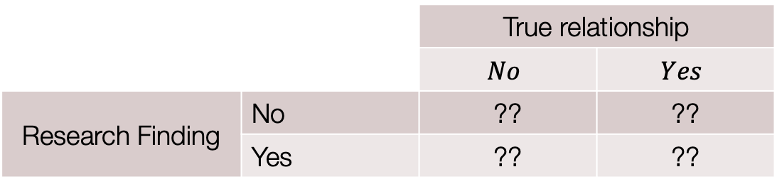
Assume that we test c associations in all …
 |  | True relationship
 |  | $$No$$ | $$Yes$$
Research Finding | No | ?? | ??
 | Yes | ?? | ??
Poll: How many of the c associations tested would we claim as a research
finding when in fact they are not true associations?
Assume c = 100,000
P0 = 0.0001
Type I error, α = 0.05
Type II error, β = 0.3
Ioannidis 2005

Slide 38

Assume that we test c associations in all …
 |  | True relationship
 |  | $$No$$ | $$Yes$$
Research Finding | No | ?? | ??
 | Yes | c . (1 – P0) . α | ??
Poll: How many of the c associations tested would we claim as a research finding when
in fact they are not true associations?
The number of true relationships = c x P0 = 100,000 x 1e-4 =10
The number of false relationships = c x (1 – P0) = 99990
The number of false relationships claimed as a research finding = c x (1 – P0) x α = 5000
Ioannidis 2005

Slide 39
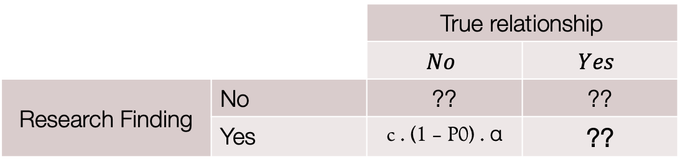
Assume that we test c associations in all …
 |  | True relationship
 |  | $$No$$ | $$Yes$$
Research Finding | No | ?? | ??
 | Yes | c . (1 – P0) . α | ??
Poll: How many of the c associations tested would we claim as a research finding when
in fact they are true associations?
The number of true relationships = c x P0 = 100,000 x 1e-4 =10
The number of true relationships claimed as a research finding = c x P0 x (1 – β) = 7
Ioannidis 2005

Slide 40
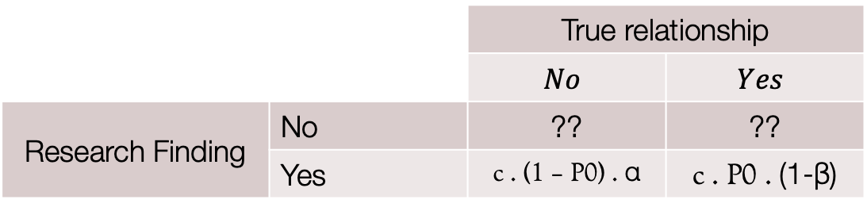
Only a very tiny fraction (0.1%) of your research findings would be true findings!!
 |  | True relationship
 |  | $$No$$ | $$Yes$$
Research Finding | No | ?? | ??
 | Yes | c . (1 – P0) . α | c . P0 . (1-β)
Poll: How many of the c associations tested would we claim as a research finding when
in fact they are true associations?
Pre-study probability of finding a true relationships = P0 = 1e-4
Post-study probability of finding a true relationships = $\frac{c.P0.(1−β)}{c.P0.\left(1−β\right)+c.P0.α}=\frac{7}{7+5000}=0.0014$
Ioannidis 2005

Slide 41
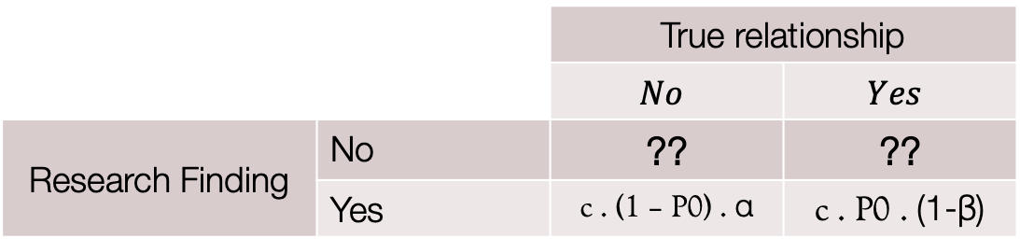
 |  | True relationship
 |  | $$No$$ | $$Yes$$
Research Finding | No | ?? | ??
 | Yes | c . (1 – P0) . α | c . P0 . (1-β)
Poll: How many of the c associations tested would we not claim as a research finding when
in fact they are true associations?
Poll: How many of the c associations tested would we correctly not claim as a research
finding?
Ioannidis 2005

Slide 42
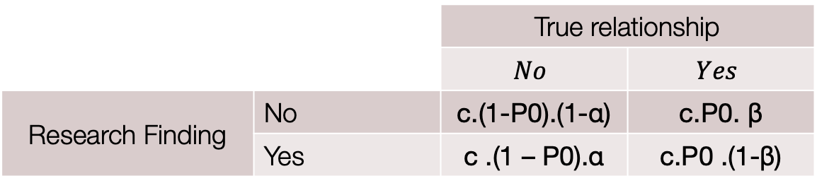
 |  | True relationship
 |  | $$No$$ | $$Yes$$
Research Finding | No | c.(1-P0).(1-α) | c.P0. β
 | Yes | c .(1 – P0).α | c.P0 .(1-β)
Poll: How many of the c associations tested would we not claim as a research finding when
in fact they are true associations?
Poll: How many of the c associations tested would we correctly not claim as a research
finding?
Ioannidis 2005

Slide 43
Terminology for Hypothesis Testing
Estimate relationships between variables
Response variables, predictor variables
Test statistic
Sampling distribution of the test statistic
Type of variable: Continuous and categorical
What are the variables whose association we are interested in estimating?
What types are these variables?

Slide 44
Z/T-statistic

Slide 45
T-statistic and sampling distribution

Slide 46
Continuous response and categorical predictor
Y: gene expression
X: development time
One-way ANOVA – F-statistics

Slide 47
Two categorical variables
 | In TGF-b signaling pathway | Not in TGF-b signaling pathway
Differentially expressed | 20 | 980
Not differential expressed | 80 | 18920
Y1: gene differentially expressed or not
Y2: gene in TGF-b signaling pathway or not
Odds ratio, Chi-square statistics

Slide 48
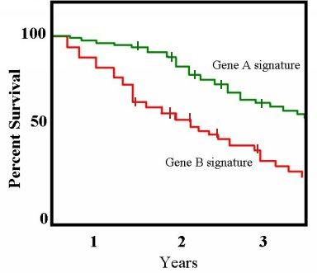
Continuous response with a categorical variable
https://commons.wikimedia.org/wiki/File:Km_plot.jpg
Y: survival time in years
X: Gene signature
Hazard ratio, logrank test

Slide 49
Continuous response against a continuous variable
Y: Child’s height
X: Parent’s height
Slope, linear regression

Slide 50
Seven pillars of statistical wisdom
Aggregation
Information
Inter-comparison
Likelihood
Regression
Residuals
Experimental design
https://commons.wikimedia.org/wiki/File:Seven_Pillars_2008_e5.jpg
Stephen M. Stigler. 2016. Seven Pillars of Statistical Wisdom. Harvard University Press

Slide 51
4. Likelihood: model variation in the location of data using probability
The sampling distribution of the mean approaches a normal distribution as the size
of the sample increases, regardless of the shape of the original population distribution

Slide 52
Poll: Which of these genes are differentially expressed?

Slide 53
Look at distribution of p-values
No real differences
Possible differences
Multiple testing procedures: Holm, Benjamini-Hochberg

Slide 54
Seven pillars of statistical wisdom
Aggregation
Information
Inter-comparison
Likelihood
Regression
Residuals
Experimental design
https://commons.wikimedia.org/wiki/File:Seven_Pillars_2008_e5.jpg
Stephen M. Stigler. 2016. Seven Pillars of Statistical Wisdom. Harvard University Press

Slide 55
7. Design: Capture effects of interest and avoid unwanted variation
Identify the response and variable(S) of interest
Identify target population that you want to base your claims on
Identify factors that affect the response of interest
Choose samples from target population
Randomly assign samples across different levels of factors affecting response
Block out variation that is not of interest by randomly assigning to levels of factors within a block

Slide 56
Which is better? Design 1 or Design 2?
 | Design 1 – Sample prep date | Design 2 – Sample prep date
Sample_1_E9.5 | Jan 9th, 2019 | Jan 11th, 2019
Sample_2_E9.5 | Jan 9th, 2019 | Jan 9th, 2019
Sample_3_E9.5 | Jan 9th, 2019 | Jan 11th, 2019
Sample_4_E9.5 | Jan 9th, 2019 | Jan 9th, 2019
Sample_1_E11.5 | Jan 11th, 2019 | Jan 11th, 2019
Sample_2_E11.5 | Jan 11th, 2019 | Jan 9th, 2019
Sample_3_E11.5 | Jan 11th, 2019 | Jan 11th, 2019
Sample_4_E11.5 | Jan 11th, 2019 | Jan 9th, 2019

Slide 57
Which is better? Design 1 or Design 2?
 | Design 1 – Gender | Design 2 - Gender
Sample_1_E9.5 | Male | Male
Sample_2_E9.5 | Male | Female
Sample_3_E9.5 | Male | Male
Sample_4_E9.5 | Male | Female
Sample_1_E11.5 | Female | Male
Sample_2_E11.5 | Female | Female
Sample_3_E11.5 | Female | Male
Sample_4_E11.5 | Female | Female

Slide 58
Which is better? Design 1 or Design 2?
 | Design 1 – Sample prep date and Gender | Design 2 – Sample prep date and Gender
Sample_1_E9.5 | Jan 11th, Male | Jan 11th, Male
Sample_2_E9.5 | Jan 9th, Female | Jan 9th, Male
Sample_3_E9.5 | Jan 11th, Female | Jan 11th, Female
Sample_4_E9.5 | Jan 9th, Male | Jan 9th, Female
Sample_1_E11.5 | Jan 11th, Male | Jan 11th, Male
Sample_2_E11.5 | Jan 9th, Female | Jan 9th, Male
Sample_3_E11.5 | Jan 11th, Male | Jan 11th, Female
Sample_4_E11.5 | Jan 9th, Female | Jan 9th, Female

Slide 59
How many n? What do we need to perform statistical power calculations?
What is the experimental design?
Identify parameters of interest given experimental design – two variables design to more complex multivariate designs
Test statistic for the parameters of interest
Estimates of variation and correlation between variables of interest – use pilot data or publicly available data
Sampling distribution of this test statistic
Check assumptions for the validity of the sampling distributions

Slide 60
Sampling to maximize chance of identifying an association
You would like to identify gene expression associations with changes in behavior and/or
histopathology in the brains of Alzheimer’s disease mice.
You have already run behavior and histopathological assays on randomly sampled mice from a
group of Alzheimer’s disease mouse models.
You have the budget for only 4 gene expression assays
Behavior
Histopathology

Slide 61
Genotype and development time effect on gene expression
E11.5
E9.5
KO
WT

Slide 62
Cellular reprogramming efficiency as a function of Wnt and Bmp levels

Slide 63
Genotype effect on gene expression

Slide 64
Litter effect dominates the variation

Slide 65
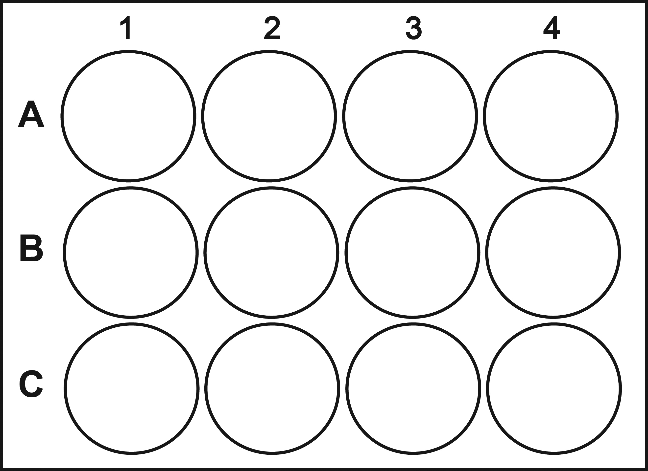
Plate design: Response over time
Before treatment with drug
After treatment with drug
No drug
Low dose
High dose
http://www.cellsignet.com/media/plates/12.jpg

Slide 66
Gene expression association: smaller effect size

Slide 67
Longitudinal data design

Slide 68
scRNA-seq data for 3 conditions

Slide 69
scRNA-seq data for 3 conditions
Mut
WT
WT

Slide 70
Seven pillars of statistical wisdom
Aggregation
Information
Inter-comparison
Likelihood
Regression
Residuals
Experimental design
https://commons.wikimedia.org/wiki/File:Seven_Pillars_2008_e5.jpg
Stephen M. Stigler. 2016. Seven Pillars of Statistical Wisdom. Harvard University Press

Slide 71
Please give us feedback
https://www.surveymonkey.com/r/F75J6VZ
~3 min

Slide 72
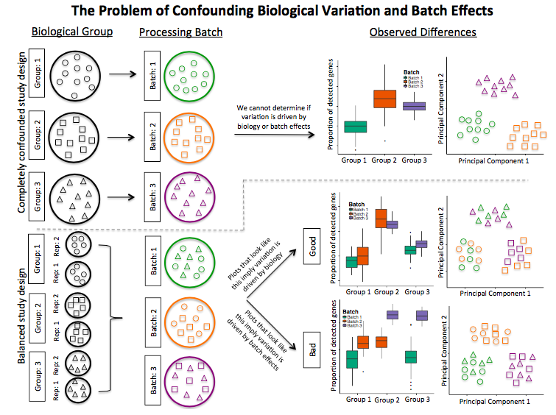

Slide 73
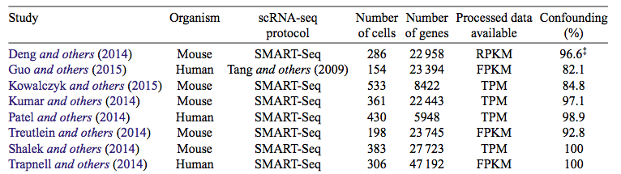
Confounding in scRNA-seq data is a big problem
Hicks, S. C., Townes, F. W., Teng, M. & Irizarry, R. A. Missing data and technical variability in single-cell
RNA-sequencing experiments. Preprint available from:https://doi.org/10.1093/biostatistics/kxx053 (2017).

Slide 74
Density
Distribution

Slide 75
Seven pillars of statistical wisdom
Aggregation
Information
Inter-comparison
Likelihood
Regression
Residuals
Experimental design
https://commons.wikimedia.org/wiki/File:Seven_Pillars_2008_e5.jpg
Stephen M. Stigler. 2016. Seven Pillars of Statistical Wisdom. Harvard University Press

Slide 76
I have no faith in anything short of actual measurement and the Rule of Three
– Charles Darwin

Slide 77
Rule of three

Slide 78
5. Regression: associate multiple (noisy) factors with each other
Tall parents tend to have shorter children while tall children tend to have shorter parents

Slide 79
Seven pillars of statistical wisdom
Aggregation
Information
Inter-comparison
Likelihood
Regression
Residuals
Experimental design
https://commons.wikimedia.org/wiki/File:Seven_Pillars_2008_e5.jpg
Stephen M. Stigler. 2016. Seven Pillars of Statistical Wisdom. Harvard University Press

Slide 80
7. Residual: Variation left over after we have captured the known effects

Slide 81
Residual: Predicted - Observed
Full model
Mean model

Slide 82
Predict child’s height from parent’s height

Slide 83
Distribution of error in predicting child’s height

